Slide 1

BCSE205L
Computer Architecture and Organization
Digital Assignment – 2
Smart Traffic Solution: IR-Based Detection and Automatic Signal Adjustment
BATCH - 9
Mukund V - 21BLC1194
B Haricharan - 21BLC1147
Sai Krishna Kanth VS - 21BLC1211
Rajvardhan J - 21BLC1216
Divyansh R - 21BLC 1123
Devendra - 21BLC1239

Slide 2
Smart Traffic Solution: IR-Based Detection and Automatic Signal Adjustment
Optimizing Traffic Flow with Infrared Sensors

Slide 3
Introduction
Traffic is a common issue confronting metropolitan regions all over the planet, with critical financial, natural and social effects. The article closes with the introduction of reenactment results and genuine examinations did to assess the proficiency of the proposed framework. Arduino microcontrollers are reasonable, simple to program, and broadly accessible, making them appropriate for huge scope sending. To take care of this issue, scientists investigated creative methodologies, for example, density based traffic light frameworks utilizing Arduino microcontrollers and IR sensors. Infrared sensors give a dependable method for identifying vehicles and catch constant traffic density information.
The utilization of Arduino microcontrollers and IR sensors offers a few benefits for the execution of the proposed density based traffic light framework. These sensors are associated with Arduino microcontrollers which process the information and arrive at insightful conclusions about traffic signal timing. By progressively changing the sign term in view of continuous density data, the proposed framework can upgrade traffic stream and diminish blockage. Thusly, this exploration paper presents a density based traffic light framework involving Arduino microcontrollers and IR sensors as a promising answer for diminish traffic. This examination paper likewise means to give an extensive outline of related research on density based traffic the executives utilizing Arduino and IR sensors. By progressively changing traffic signal timing continuously founded on vehicle density, the proposed framework plans to upgrade traffic stream and diminish blockage at convergences. Customary fixed-time traffic signal frameworks don't adjust to dynamic traffic circumstances, bringing about wasteful traffic the executives.

Slide 4
Literature Survey
S.No | Title /Publisher | Authors | Year of Publication | Methodology | Advantage | Drawbacks
1. | Smart Traffic Control System for Clearance to Emergency Vehicles Using Arduino Software. | Vahedha,Dr.B.Naga Jyoth | 2016 | The RFID tags are placed on emergency vehicles. The RFID readers are placed at intersections The Arduino boards are connected to the RFID readers. | It can help to reduce the response time of emergency vehicles. It can help to improve traffic flow. | It can be expensive to install and maintain. It can be difficult to install in areas with a lot of traffic.
2. | Applications: Automated Intelligent Traffic Control System Using Sensors. | Ashid H, Sandhya S,Vinita S,and Sandhya S | 2013 | System Design: Develop a conceptual design of the automated intelligent traffic control system. | Scalability and flexibility: Wireless Sensor Networks (WSNs) provide a scalable and flexible infrastructure | Intelligent traffic control systems collect and process a vast amount of data, including vehicle movement patterns and potentially personal information.

Slide 5
3. | Traffic Light Systems, International Journal of Emerging Research in Management & Technology | Vinidha RA | 2017 | Data collection: The first step is to collect data about traffic conditions. This data can be collected using a variety of sensors, including cameras, radar, and lidar. | Increased environmental sustainability: Smart traffic light systems can help to reduce air pollution and greenhouse gas emissions | Limited Compatibility: Integrating a smart traffic light system with existing infrastructure and legacy systems can be challenging.
4. | Traﬃc density determination and its applications using smartphone | Al-Sayed Ahmed Al-Sobky | 2016 | The proposed system uses two cars equipped with synchronized smartphones to monitor traffic density. An observer in the lag car counts vehicles between the lead and lag cars | Wide Coverage: Smartphones are ubiquitous and can be found in the hands of most people. | The application of the proposed system with its current setupis limited to situations of low percentages of heavy vehicles andbuses.

Slide 6
5. | A Review of the Self-Adaptive Traffic Signal Control System Based on Future Traffic Environment | Yizhe Wang,1Xiaoguang Yang | 2018 | Traffic congestion in urban roads and freeways can be countered via suitable control measures and strategies such as traffic signal control. Modern control theory and artificial intelligence (AI) | The development and application of new technologies such as connected vehicles, autonomous vehicles, and advanced infrastructure will greatly promote the development of urban traffic control systems. | One major disadvantage of existing traffic control systems is their heavy reliance on prior feedforward or delay-based limited information control methods, which depend on accurate models of traffic environments and cannot adjust control knowledge based on feedback.

Slide 7
List of Components
Arduino UNO
Transformer (12-0-12)
.IC 74HC595 (serial to parallel)
CAPACITOR (0.1 microfarad - 2 1000 microfarad - 1)
DIODE (1N4007 - 2)
RESISTORS (470 ohm)
VOLTAGE REGULATOR (IC 7809 - 1)
LEDS (green - 3 Yellow - 3 Red - 4)
CONNECTING WIRES (As per required)

Slide 8
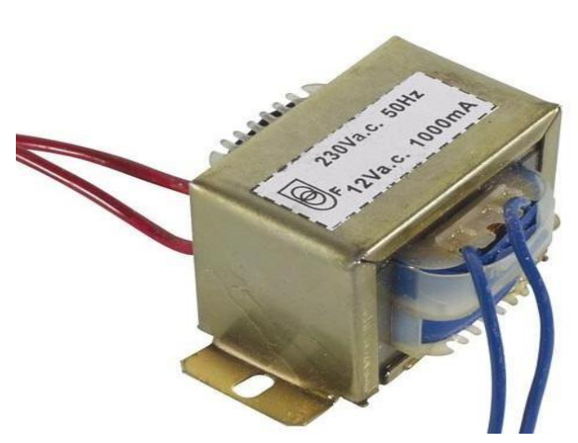
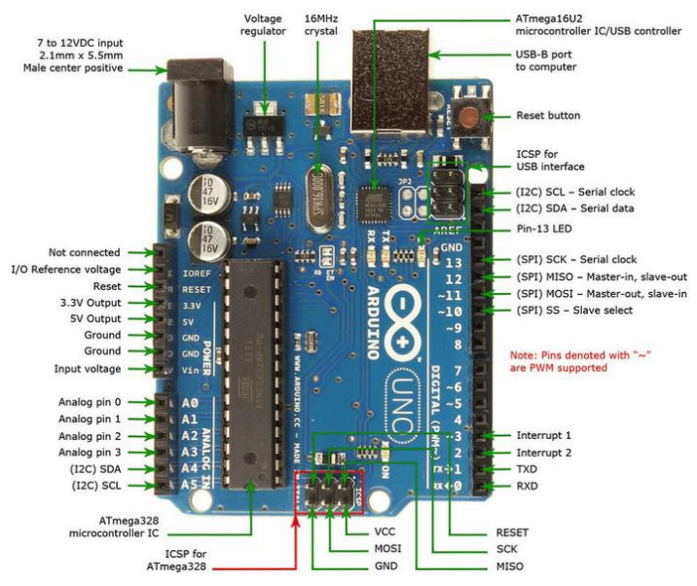
Components
Transformer 2. Arduino UNO

Slide 9
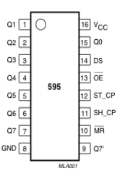
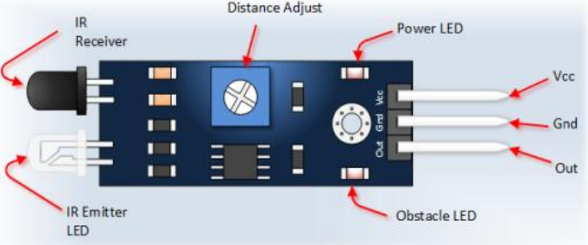
Components
3. IR Sensors 4. IC 74HC595

Slide 10
Work Plan
For this experiment we required ATmega32 microcontroller.
We will Connect IR sensors To Port C And Traffic Light To Port A and Port B.
If there is traffic on road then IR sensor output becomes 0 otherwise logic 1 by receiving these IR output.
Basically We divide this project into Two parts , One is writing code and stimulate in software and other is by doing hardware .
Develop software for data processing: Develop a software program that can process the data collected by the IR sensors and convert it into useful information such as the number of vehicles passing through the intersection during specific time intervals.
Implement a signal adjustment algorithm: Develop an algorithm that uses the processed data to adjust the timing of traffic signals in real-time based on the traffic density measured by the IR sensors.
Why we are using ATmega32?
ATmega is a low Power Cmos 8 BIT microcontroller.
It executes powerful instruction n a single clock cycle.
Advanced RISC architecture.
It has Internal EEPROM(electrically erasable program read only memory) which helps us to store small of amount of data.

Slide 11
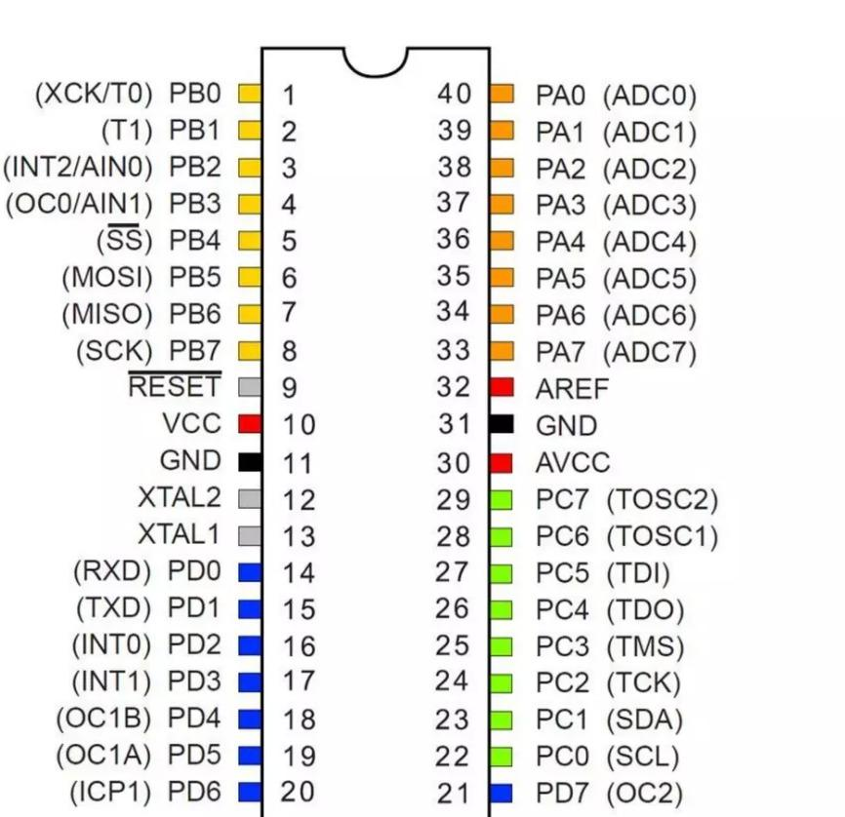
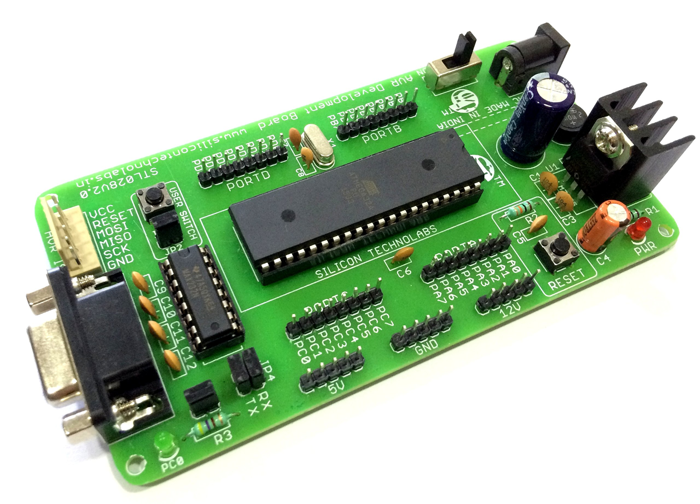
To Work With ATmel AVR microcontroller using c Programming language tools required :- Fritzing
Then we will Stimulate our circuit using software called Proteus .
IR sensors emit infrared radiation and measure the reflection of that radiation off the vehicles on the road. The sensors are typically mounted on traffic light poles or other structures along the road.
Here We need PCB (Printed Circuit board ) Attach ATmega microcontroller to it . We need 4 -5 IR sensor And Some Yellow , Green , red LED’S .
ATMEGA32 PIN DIAGRAM —

Slide 12
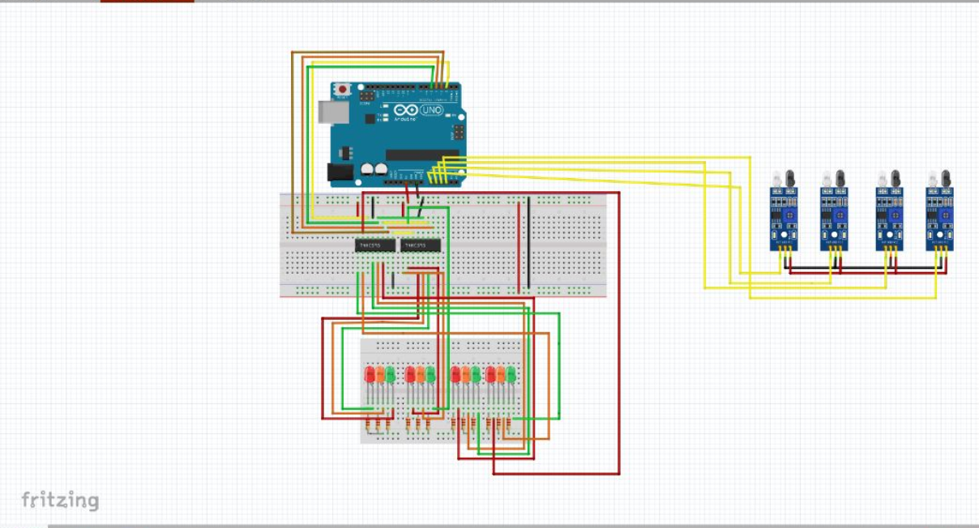
Circuit Diagram

Slide 13
Code For Implementation Of Hardware And Software
// Define NOP assembly instruction for delay
#define NOP __asm__("nop")
// LED pattern
unsigned int pattern = 0b0001000100010010; // RED | RED | RED | GR
unsigned int maskPattern[4] = {0xFFF0, 0xFF0F, 0xF0FF, 0x0FFF};
// Sensor variables
int presentSensorId = 0; // Initial value
int nextSensorId = 1; // Initial value
int sensorCount = 4;
// Time constants
const long greenDelay = 10000; // 10 sec
const long yellowDelay = 4000; // 4 sec
// Sensor Pins
int sensorPin[4] = {A0, A1, A2, A3};
// Shift Register (SHR) control pins
int SER = 2;
int RST = 3;
int inClk = 4;
int outClk = 5;
// Function to initialize the sensor pins
void init_Port() {
pinMode(sensorPin[0], INPUT);
pinMode(sensorPin[1], INPUT);
pinMode(sensorPin[2], INPUT);
pinMode(sensorPin[3], INPUT);
}
// Function to initialize the LED lights and shift register
void init_Light() {
pinMode(SER, OUTPUT);
pinMode(RST, OUTPUT);
pinMode(inClk, OUTPUT);
pinMode(outClk, OUTPUT);
// Set initial pin states to LOW
digitalWrite(SER, LOW);
digitalWrite(RST, LOW);
digitalWrite(inClk, LOW);
digitalWrite(outClk, LOW);
delay(500);
// Generate a pulse on inClk and outClk pins for initialization
digitalWrite(inClk, HIGH);
delay(10);
digitalWrite(outClk, HIGH);
delay(10);

Slide 14
// Function to display the current LED signal pattern
void displaySignal() {
write_LED(byte(pattern & 0xFF), byte(pattern >> 8));
}
// Function to update the signal from green to yellow
void green2yellowUpdate() {
unsigned int musk_presentSensorId;
unsigned int musk_nextSensorId;
pattern = 0b0001000100010001; // Default make all red then change
musk_presentSensorId = maskPattern[presentSensorId];
musk_nextSensorId = maskPattern[nextSensorId];
pattern = pattern & musk_presentSensorId;
pattern = pattern | (0b0100 << presentSensorId * 4); // Load yellow pattern
pattern = pattern & musk_nextSensorId;
pattern = pattern | (0b0100 << nextSensorId * 4); // Load yellow pattern
}
// Function to update the signal from yellow to green
void yellow2greenUpdate() {
unsigned int musk_nextSensorId;
pattern = 0b0001000100010001; // Default make all red then change
musk_nextSensorId = maskPattern[nextSensorId];
pattern = pattern & musk_nextSensorId;
pattern = pattern | (0b0010 << nextSensorId * 4); // Load green pattern
}
}
}
digitalWrite(inClk, LOW);
NOP;
digitalWrite(outClk, LOW);
digitalWrite(RST, HIGH);
}
// Function to write LED pattern to the shift register
void write_LED(byte val1, byte val2) {
digitalWrite(outClk, LOW);
NOP;
digitalWrite(inClk, LOW);
NOP;
// Shift out the values to the shift register
shiftOut(SER, inClk, MSBFIRST, val2);
shiftOut(SER, inClk, MSBFIRST, val1);
NOP;
digitalWrite(outClk, HIGH);
NOP;
NOP;
NOP;
digitalWrite(outClk, LOW);
NOP;
digitalWrite(inClk, LOW);
NOP;
}

Slide 15
// Function to update the current sensor ID based on road occupancy
void sensorIdUpdate() {
int I;
int busyFlag = 0; // Reset value
// Check the sensors after the current sensor
for (I = presentSensorId; I < sensorCount; I++) {
if ((I != presentSensorId) && (digitalRead(sensorPin[I]) == LOW)) {
nextSensorId = I;
busyFlag = 1;
break;// If no busy road found after the current sensor, check the sensors before the current sensor
if (busyFlag == 0) {
for (I = 0; I < presentSensorId; I++) {
if ((I != presentSensorId) && (digitalRead(sensorPin[I]) == LOW)) {
nextSensorId = I;
busyFlag = 1;
break;
}
}
}
// If no road is busy, regular update by incrementing the current sensor ID
if (busyFlag == 0) {
nextSensorId = (presentSensorId + 1) % sensorCount;
}
}
void setup() {
Serial.begin(9600);
Serial.println(" ------- Automatic Traffic Light Control based on Density --------");
// Initialize the sensor pins
init_Port();
// Initialize the LED lights and shift register
init_Light();
}
void loop() {
// Display the current LED signal pattern
displaySignal();
// Delay for the green signal duration
delay(greenDelay); // Update the sensor ID based on road occupancy
sensorIdUpdate();
// Update the signal from green to yellow
green2yellowUpdate();
// Display the updated LED signal pattern
displaySignal();
// Delay for the yellow signal duration
delay(yellowDelay);
// Update the signal from yellow to green
yellow2greenUpdate();
// Update the present sensor ID
presentSensorId = nextSensorId;
// Update the sensor ID for the next iteration
sensorIdUpdate();
}

Slide 16
Methodology:
1) IR Sensor Position:
Select the best intersections or roadway segments to install IR sensors. Think about variables like view perceivability, inclusion region, and sensor distance. A crucial arrangement ensures that cars passing through the examined area may be successfully located.
2) Vehicle Location:
IR sensors are used to locate automobiles in certain locations or zones. When a vehicle passes within the identification zone, it interferes with the sensor's infrared beam. The sensor detects the interference, indicating the presence of a vehicle.
3) Density Assessment:
Using the data obtained from the IR sensors, calculations are made to evaluate the vehicle density. This can include examining the span and recurrence of breaks in the IR bar brought about by passing vehicles.

Slide 17
4) Information Handling:
The information gathered from the IR sensors is handled utilizing Arduino microcontrollers or comparable gadgets. These microcontrollers get the sensor information and perform calculations to total and dissect the density data continuously. The information handling calculations might include separating procedures, factual investigation, or AI ways to deal with work on the precision of density assessment.
5) Traffic Light Timing:
Calculations are created to progressively change the timings of traffic lights in view of the assessed vehicle density. These calculations plan to improve traffic stream and decrease blockage by adjusting signal stages, cycle lengths, and green time allotments in light of changes in rush hour traffic conditions. The objective is to distribute more green chance to bearings with higher vehicle density to work with smoother traffic stream.

Slide 18
Conclusion
In conclusion, IR-based traffic density detection and signal adjustment is a promising technology that can help to manage traffic flow at intersections more efficiently. By using IR sensors to detect the presence and density of vehicles, the system can accurately measure traffic conditions in real-time and adjust the timing of traffic signals accordingly. This can help to reduce traffic congestion, improve travel times, and enhance overall safety on the roads.
However, it's important to note that implementing such a system requires careful planning, testing, and ongoing maintenance to ensure its success. The accuracy and reliability of the IR sensors, software processing, and algorithm used to adjust traffic signals must be thoroughly tested and optimized before installation at an actual intersection. Additionally, ongoing monitoring and support will be required to address any issues that may arise and make necessary improvements to the system over time.Overall, IR-based traffic density detection and signal adjustment has great potential to improve traffic management and enhance the driving experience for commuters in urban areas. With proper planning and execution, this technology could play a vital role in creating safer, more efficient transportation systems for our cities.

Slide 19
References
H. K. Lo and H. F. Chow, “Adaptive traffic control system: Control strategy, prediction, resolution, and accuracy,” Journal of Advanced Transportation, vol. 36, no. 3, pp. 323–347, 2002.
A. Stevanovic, “Adaptive traffic control systems: Domestic and foreign state of practice,” NCHRP Synthesis 403, Transportation Research Board, Washington, D.C., 2010.
N. H. Gartner, C. Stamatiadis, and P. J. Tarnoff, “Development of advanced traffic signal control strategiesfor intelligent transportation systems: multilevel design,” Transportation Research Record, no. 1494, pp. 98–105, 1995.
G. Sims A, The Sydney coordinated adaptive traffic system. Engineering Foundation Conference on Research Directions in Computer Control of Urban Traffic Systems, Calif, USA, 1979.

Slide 20
N. H. Gartner, “OPAC: A demand-responsive strategy for traffic signal control,” Transportation Research Record, vol. 1983, no. 906, pp. 75–81, 1983.
P. Mirchandani and L. Head, “A real-time traffic signal control system: architecture, algorithms, and analysis,” Transportation Research Part C: Emerging Technologies, vol. 9, no. 6, pp. 415–432, 2001.
J. Hu, M. D. Fontaine, B. B. Park, and J. Ma, “Field evaluations of an adaptive traffic signal—Using private-sector probe data,” Journal of Transportation Engineering, vol. 142, no. 1, Article ID 04015033, 2016.
S. Chatterjee and B. Timande, “RFID based Traffic Control System using ARM processor perspective Kolkata and other densely populated cities,” International Journal of Advanced Research in Computer Science and Electronics Engineering, vol. 1, no. 10, pp. 32–35, 2012.
M. Papageorgiou, C. Diakaki, V. Dinopoulou, A. Kotsialos, and Y. Wang, “Review of road traffic control strategies,” Proceedings of the IEEE, vol. 91, no. 12, pp. 2043–2065, 2003.
J. C. Spall and D. C. Chin, “Traffic-responsive signal timing for system-wide traffic control,” Transportation Research Part C: Emerging Technologies, vol. 5, no. 3-4, pp. 153–163, 1997.

Slide 21
Video Link:
https://drive.google.com/file/d/1GFz-DjAp5Rff2cZB8u1oqayrRNgK0PwB/view?usp=sharing

